Slide 1
Hoath Parish Neighbourhood Plan Questionnaire:
The results
May-August 2025
This presentation is a summary. Full detail can be found in the report of aggregate data
Where relevant, percentages are of those who expressed an opinion. So excluding “blanks” from the report’s data

Slide 2
General Information
71 Replies (Q1)
125 residents (Q4)
23% < 50 yrs old ; 42% 50-70 ; 35% > 70 (Q4)
Broad representation across the village (Q3)
94% of respondents support the Neighbourhood Plan process (Q1)
  Differing levels of engagement and availability (Q2)

Slide 3
Community feeling
96% of respondents generally feel safe in Hoath (Q36)
83% agree that the streets and public spaces offer a safe environment (Q35)
For all the high concern about speeding through the village
But 71% are unsure whether levels of crime are decreasing (Q36)

Slide 4

Landscape, Green Space and Environment

Slide 5
Protection and Conservation (Q5A – Q7C)
>350 individual comments
Highly alert to local parish features
Views from Hoath, views within Hoath between hamlets
People generally live here to continue and preserve rural life
Concerned about external stakeholders and their commitment to conservation / preservation
    All of the above, including East Blean Woods, Church, Maypole, Old Tree, Shelvingford, Nethergong-Sarre Penn Valley, Rushbourne (and much more)

Slide 6
Statistics
~90% want all existing gaps between settlements preserved (Q8A)
85% want open spaces defined as Green Gaps to preserve settlement integrity (Q8B)
94% want the preservation of dark skies (Q10)
  With some comment that access to carpark could be better lit
  88% are against street lighting (Q36)
97% want preservation of natural environment (Q11)
  Tree Preservation Orders (TPOs) frequently mentioned

Slide 7
Comments
    All parish landscape features have natural and visual significance. They form part of our national and local heritage. They need protection to preserve this heritage. Of special historical significance are the open fields, medieval field structure and drainage systems
    All the areas require a measure of protection, but development is inevitable. The focus should be on the areas that can be developed without damaging the landscape to any great degree. Our view is that Maypole airfield should be considered as probably the only area for sensible commercial and residential development

Slide 8
Public Rights of Way (PROW)
64% of respondents are satisfied with rights of way (Q9A)
55% would support multi-use (Q9B)
73% support reinstatement (Q9C)
  Concern about creeping development / privatisation
  Concern about cost of reinstatement and maintenance
    Lack of maintenance

Slide 9
Comments
    Do we still have a parish PROW warden?
    Some are obstructed, farmers do not always reinstate after ploughing, CH37 needs maintenance, CB524 often impassable, CB99 has a fence across it, CB98 hasn't been marked for years
    Too many bikes can be a problem, Bikes have national routes, they don't mix with walkers and horses in countryside, nor do loose dogs. Bad for wildlife, nesting birds etc

Slide 10
Energy production
26% support renewable energy in the parish; 52% oppose; 22% Unsure (Q12A)
Solar and wind are preferred over Biomass and Anaerobic Digestion (Q12B)
Solar is popular on private homes (94%) and public buildings (84%). It is much more mixed for the car park (54%) and deeply unpopular for quality farmland (91% opposition) (Q12C)
<20% support batter energy storage systems (BESS) (Q12D)
94% support working with landowners to support climate resilience (Q13)
  An implication from replies is that people want landowners to work with parishioners, part of a general them including PROWs

Slide 11
Comments
    Only for supply and use of parish, On new and public buildings, not fields
    There should be some benefit to Hoath residents to compensate for lack of amenity
    Not on agricultural land
    I don't agree with the solar farm
    Local landowners seem to have no interest in climate resilience
    These should be built on brownfield sites. Wind should be offshore only. Solar on farmland: absolutely not! Quality farmland provides the UK with an element of food security

Slide 12

Housing and Commercial Development, Design Standards

Slide 13
Future development
Renovating and converting existing buildings is vastly preferred over infill, conservation areas and agricultural land (Q15)
  Infill may depend on scale and extent to which it affects gaps between hamlets

Slide 14
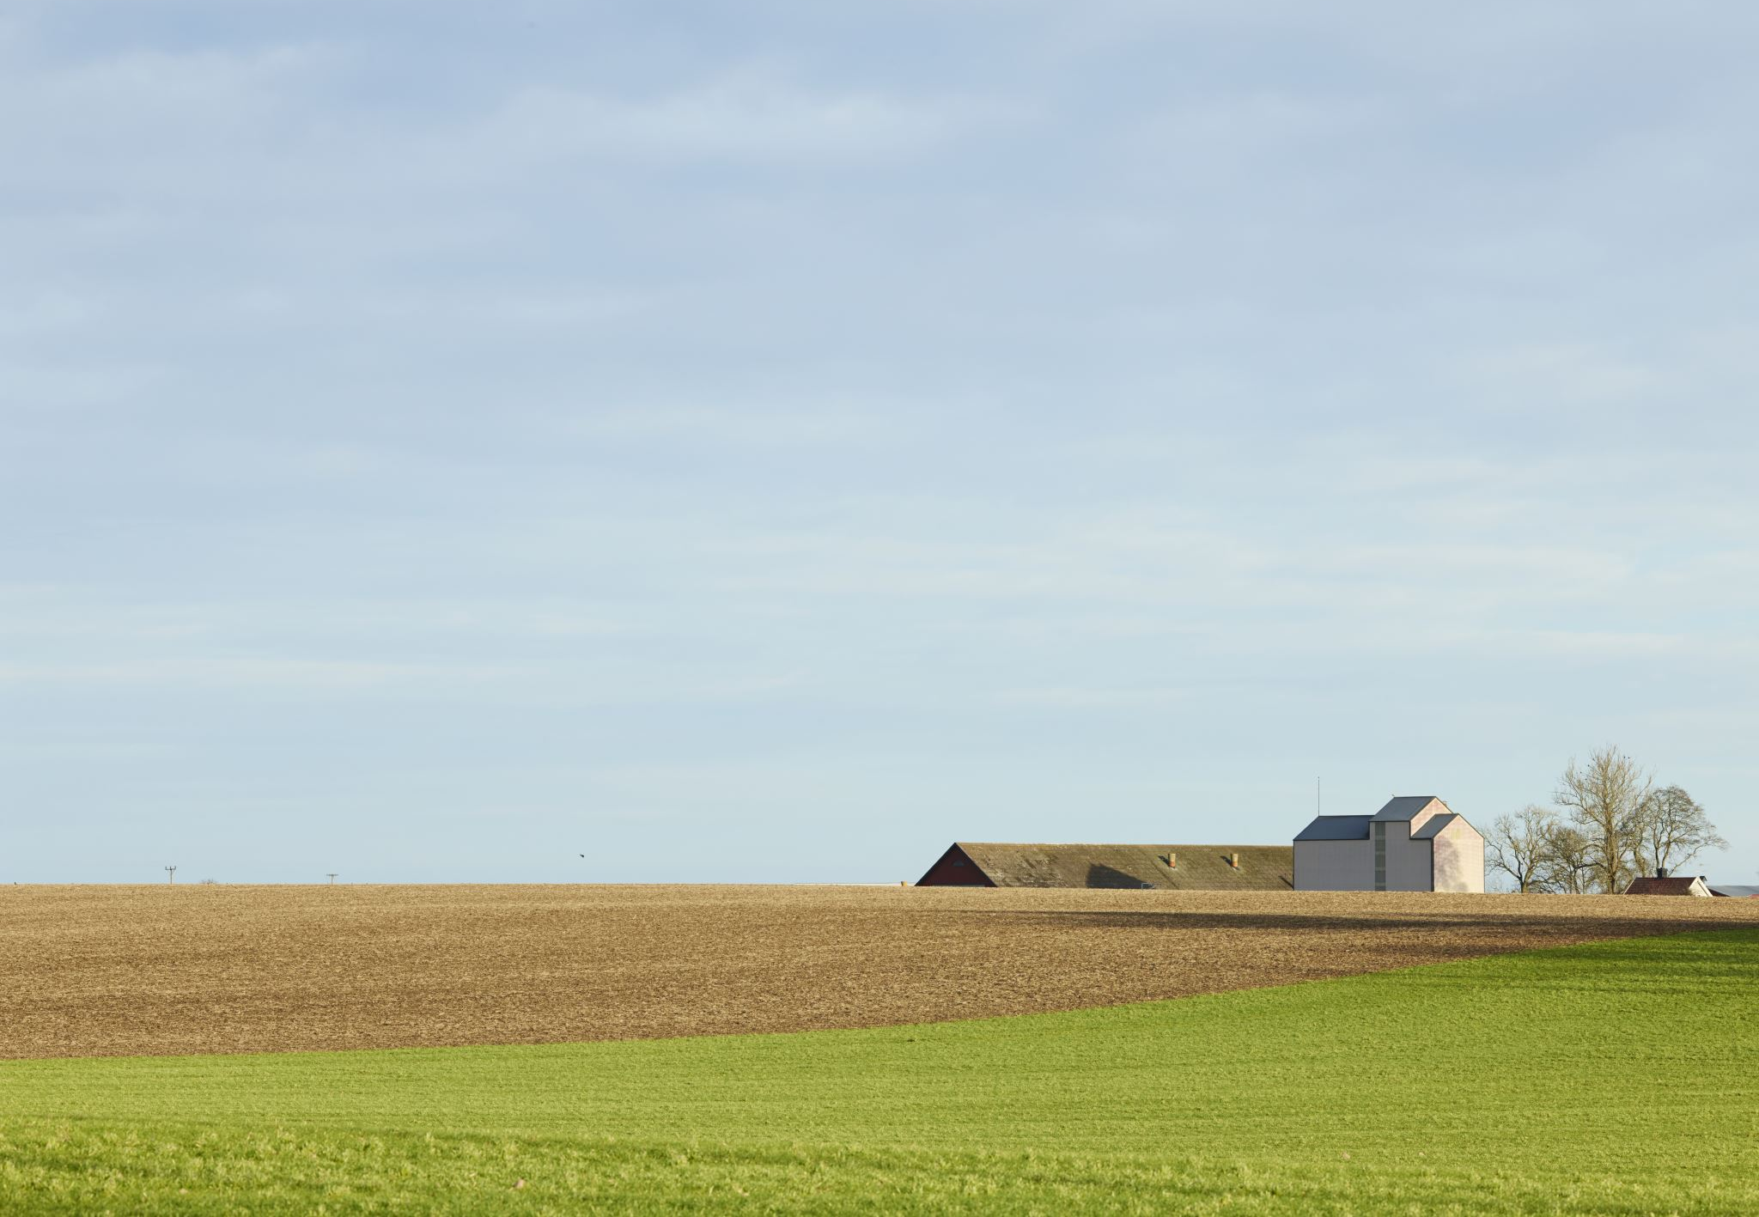
Specific developments
70% opposed to the Church Farm development proposal (15% / 15% for / unsure) (Q14)
General opposition to Maypole airfield development.
  No precise statistics. Qualitatively, opinion seems similar to Church Farm. Some minority support.
Concern about unpermitted development and lack of enforcement of infringements
Within low popularity overall, Bungalows and semi-detached (“affordable”?) preferred over retirement / care / flats (Q18)

Slide 15
Comments
    No large-scale estates ever
    Re-building of homes if not outsize for site
    Infill - as long as it is proportionate to the surroundings
    Starter homes to keep young residents in the village
    Not on farmland
    The entire area has low water pressure and cannot sustain residential development, The entire area has a low electrical network and cannot support any further development
    Development should be considered where the owner of the site requested it

Slide 16
Design Standards (Q19)
Popular: Features in keeps; Rainwater harvesting; Hedgerows; Biodiversity in gardens
Unpopular: Wooden window frames; Integrated bicycle stands; Dormer windows; pitched roofs; space for home working
  Most answers were “yes”
Seeking quality, care, sustainability, climate resilience, consistency

Slide 17
Comments
    All development to be looked at on a case by case basis
    No more housing, there is so much locally, the infrastructure does not support it i.e. roadways etc, It will soon be part of one big urban sprawl
    Seems pointless section as we will have no say. Building regs etc. Some of the questions are non-sensical. I have commented on section I consider relevant

Slide 18
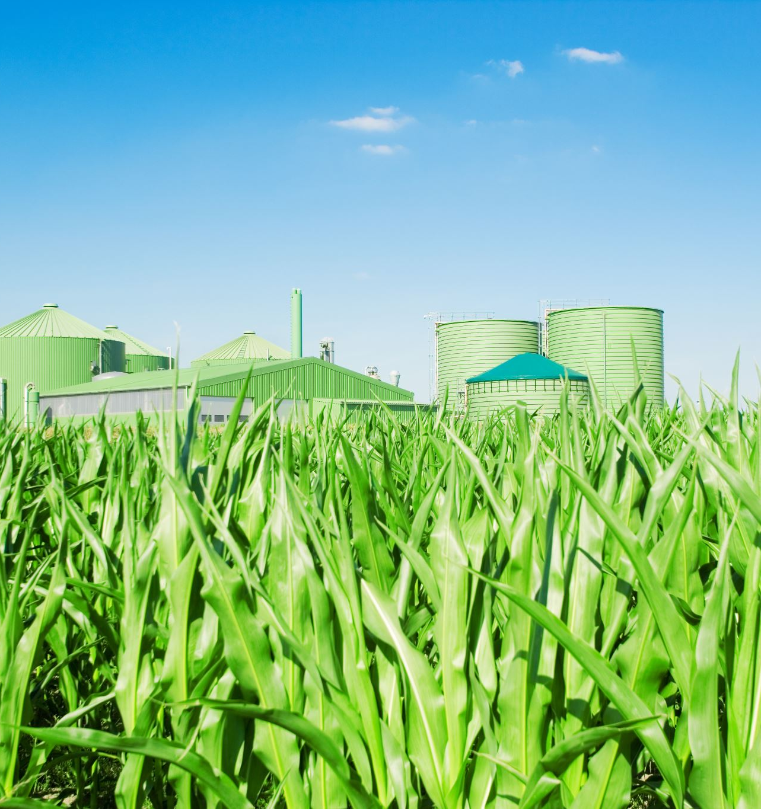
Rural Economy and Facilities

Slide 19
Areas for development
Respondents are highly supportive of land being developed for farming, horticulture, equestrian and farm / village shopping (Q20)
  Some comments about the pre-existing farm shop and failure of previous village shop
Respondents are unsupportive tourism and renewable energy
All respondents want Best & Most Versatile (BMV) farmland protected for agricultural use (Q22)

Slide 20
Comments
    Farming is what can make or break a community
    Pub … We should also support our two existing public houses
    Renewable energy - only if solar panels on roofs not farms
    Two farm shops already
    Farming: heavy vehicles need to be managed properly. Farming is important to the village but the way it is managed in the parish is destroying its character by lack of care to road use
    Village shop not financially viable on current use

Slide 21
Other ideas (Q21)
No single theme
    Fishing lake with pedestrian access
    Parish summer fayre, Entertainment Village Green, Saturday markets
    Agriscience hub, education on environmental issues
    Public transport
    Small scale homebased enterprises within existing premises (coffee refining, honey production etc) are acceptable
    Don’t waste money

Slide 22
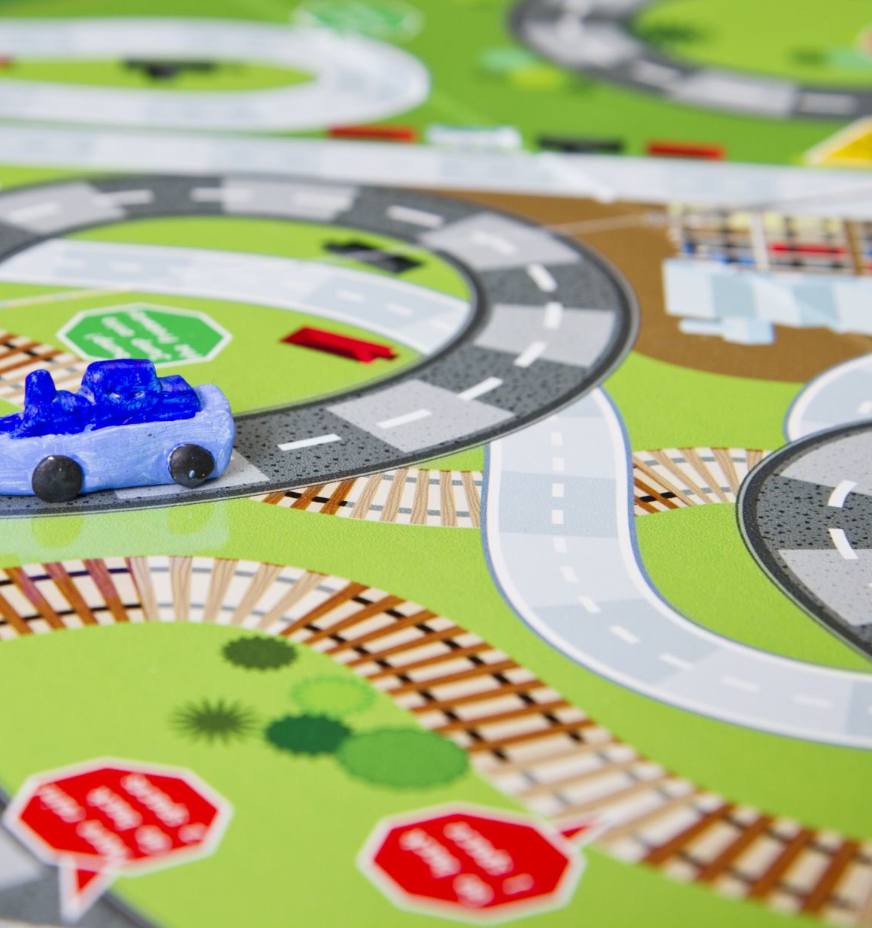
Parish Services, Amenities, Health and Wellbeing

Slide 23
Local services
79% of respondents are satisfied with local services and amenities in general (Q23)
Provision of bus routes highly popular (Q24)
Multi-use / cycling more mixed responses
  Concern more about use and impact with pedestrians

Slide 24
Local services (cont’d …)
Mixed views about whether health / wellbeing facilities are adequate (Q25)
Adult and children’s recreational facilities are popular. Adult education and work facilities less popular (Q26). Wide variety of views expressed in the comments (Q27)
Paddock mentioned but not overwhelmingly (Q34)

Slide 25
Comments & Suggestions
    Village use for village use only, not groups with whole of Canterbury catchment
    All unnecessary if transport links improved
    Table top or boot sales
    Keep fit equipment in public spaces
    Walking club
    IT courses for those who may need
    Children's play area / equipment
    Mum and toddler group
    Off road walk / run / cycle route

Slide 26
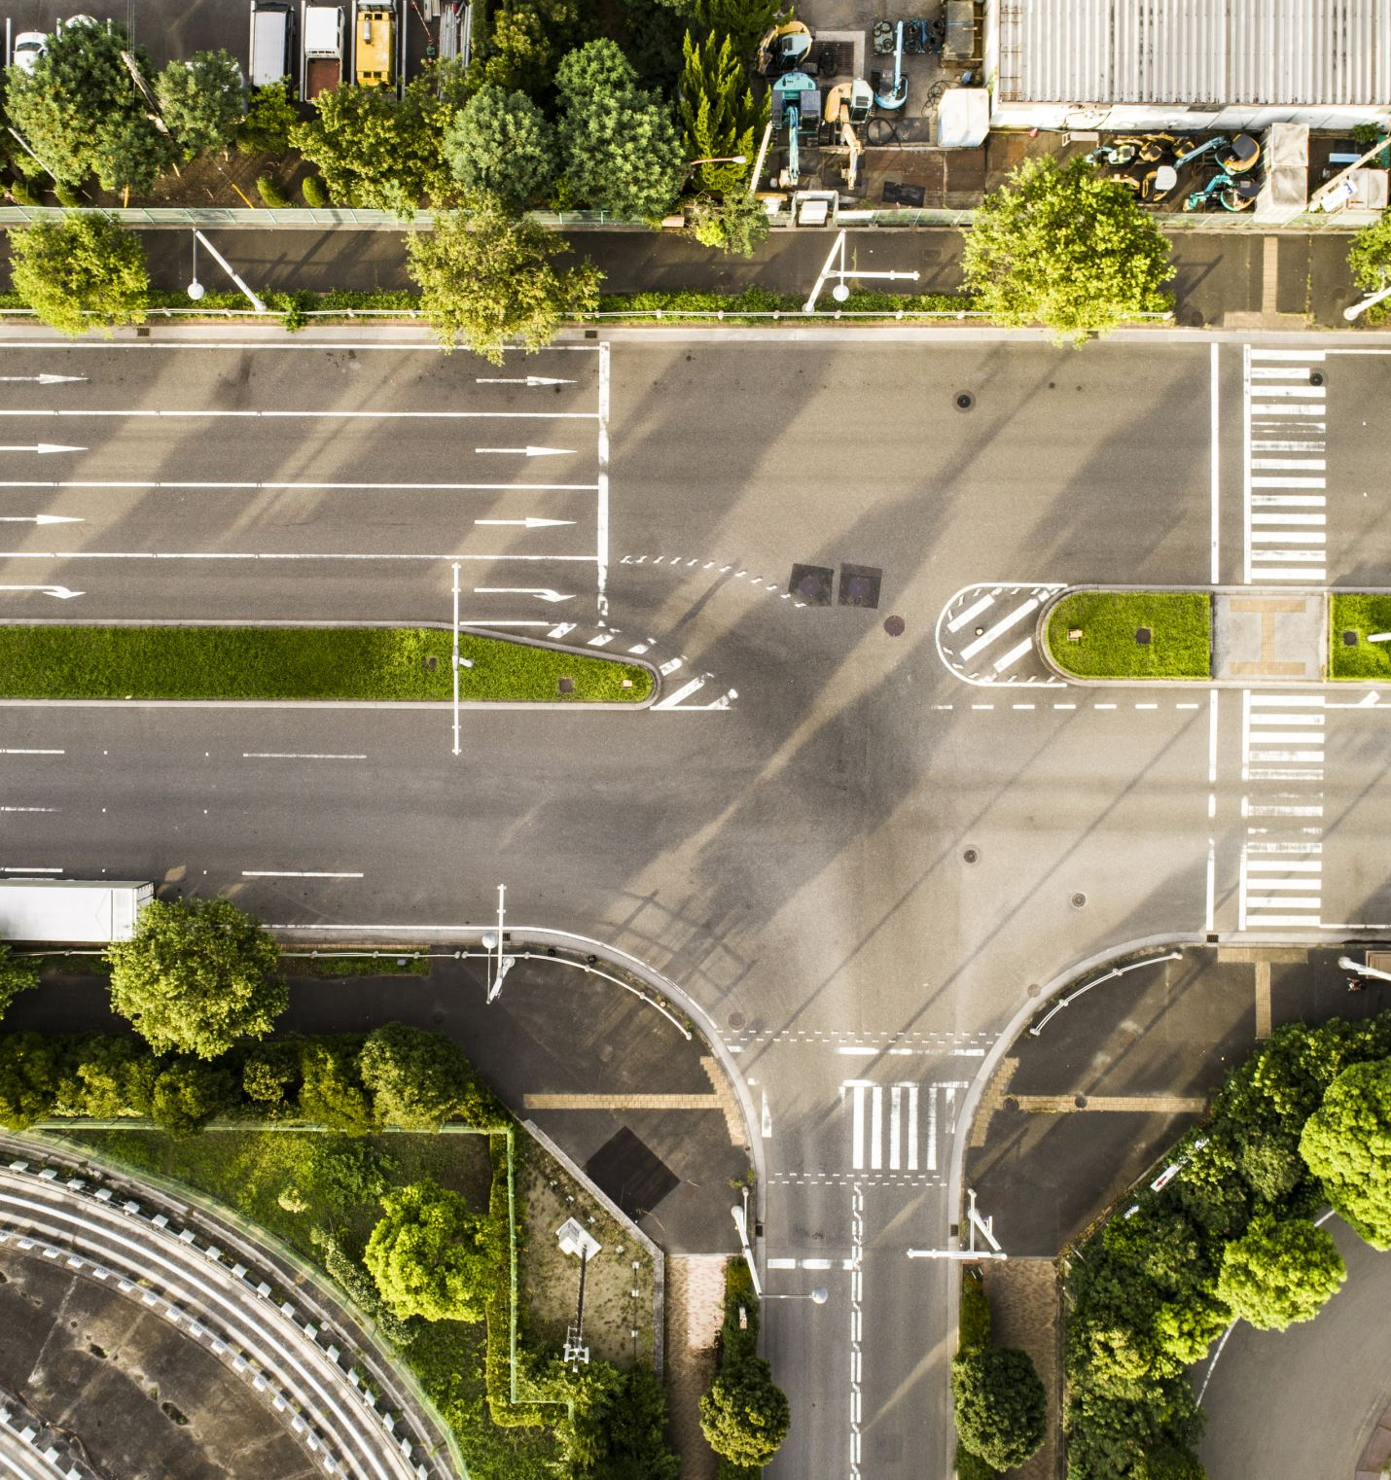
Roads, Paths, Traffic Infrastructure, Safety

Slide 27
Road safety
88% of respondents agree that road safety is a problem in the parish (Q30)
26% believe that congestion is a problem (Q31)
  School times most frequently flagged
82% believe that speed is a problem (Q32)
  Maypole Road, Hoath Road, Ford Hill, Marley Lane, Hicks Forstal commonly flagged
Potholes, road damage, litter frequently flagged (Q29, Q34)

Slide 28
Suggestions
Reduced speed limits
Enforcement, cameras
Traffic calming (speed bumps)
Signage

Slide 29
Comments
    Terrible road damage … Most roads in village damaged by diversionary traffic volumes
    [Congestion] School times only, Digestate pit and large vehicular traffic.
    Litter thrown from cars, cars / motorbikes with deliberately noisy exhausts, speeding, damage to verges from large tractors
    Our local roads are seeing significant increase in vehicles using them as "rat runs" and access to and from housing developments in surrounding areas.

Slide 30

Final thoughts

Slide 31
If we had to focus on just one thing … (Q39)
The loss of prime agricultural land, green spaces and views. This is the heritage of Hoath and a valuable resource that risks being lost in the planned "solar farm"
Building control: only sensible planning. Planning conservation applied correctly please. Stop houses being built on farmland!!
No to Solar! Protecting our environment for residents and wildlife
Traffic speed and volume. Bad roads. Roads are too narrow and in poor condition for such speed
Bus service followed by protect green / agricultural land. The children of the parish of all ages do not have a gathering place or anything to do. The elderly people do not have public transport to go to the city.
Keeping Hoath as a small rural village. It would be wonderful if Hoath could remain the same quiet rural agricultural area unspoilt by development!
[Note: these are blended responses]

Slide 32
Conclusions from the Parish Council
Discussion

Slide 33
Last Words
“Rural life is beautiful, unique and cannot be replaced … We all need to work with each other to protect and enhance our parish, the landscape and environment, promote biodiversity to create a clear shared vision for the future”
[Note: this is a blend of two responses]

